Slide 1
Ansible Automation Platform
Jim Garrett
Principal Solution Architect
jgarrett@redhat.com

Slide 2
What You Will Learn
Overview of public cloud provisioning
Converting shell commands into Ansible commands
Retrieving information from hosts
Deploying applications at scale
Self-service IT via surveys
Overview of System Roles for Red Hat Enterprise Linux
Overview of Red Hat Insights integration

Slide 3

WHAT IS ANSIBLE?
Automation Engine
IT Infrastructure
Networks - F5, Arista, Cisco,
Juniper, Open Vswitch
VYOS, others

Slide 4
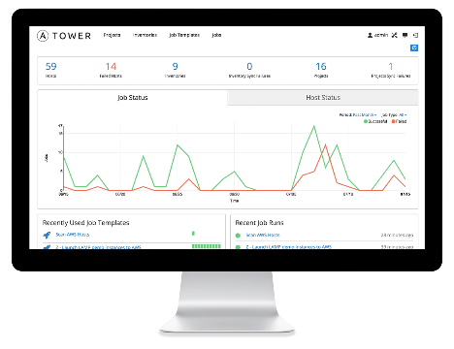
WHAT IS ANSIBLE?
It’s an automation engine - Ansible
Automate What????

Slide 5
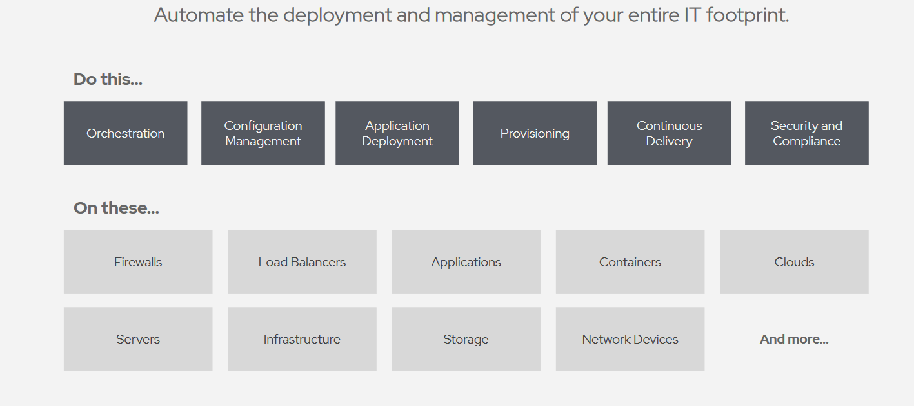
What Can I Do Using Ansible
Notes:
Orchestration – Configurations alone don’t define your environments. You need to define how multiple configurations interact and ensure the disparate pieces can be managed as a whole. Out of complexity and chaos, Ansible brings order
Config Management – centralized configuration file management and deployment is a common use case
App Deployment – when you manage your application deployment with Ansible and manage the deployment with Tower teams are able to manage the entire application lifecycle from development to production.
Provisioning – Your apps have to live somewhere. If you’re booting and kickstarting bare-metal servers or VM’s, or creating instances from templates, Ansible and Ansible Tower help streamline the process.
Continuous Delivery – Creating a CI/CD pipeline requires buy-in from numerous teams. You can’t do it without a simple automation platform that everyone in your organization can use. Ansible Playbooks keep your applications properly deployed and managed throughout their entire lifecycle
Security – When you define your security policy in Ansible, scanning and remediation of site-wide security policy can be integrated into other automated process and instead of being an afterthought, it’ll be integral in everything that is deployed

Slide 6
WHAT IS ANSIBLE?
It’s an automation engine - Ansible
It’s an automation language - Ansible Playbooks.
Enterprise framework for controlling, securing and managing your automation – Ansible Tower

Slide 7
SIMPLE
POWERFUL
Agentless
Human readable automation
No special coding skills needed
Tasks executed in order
Get productive quickly
Configuration management
App deployment
Workflow orchestration
Orchestrate the app lifecycle
Agentless architecture
Uses OpenSSH & WinRM
More efficient & more secure

Slide 8
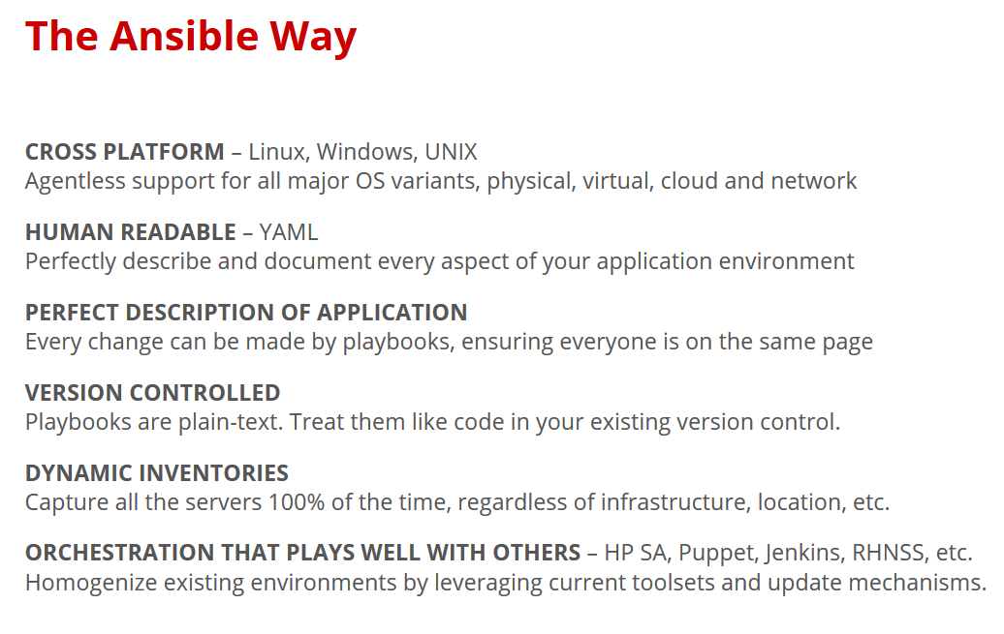

Slide 9
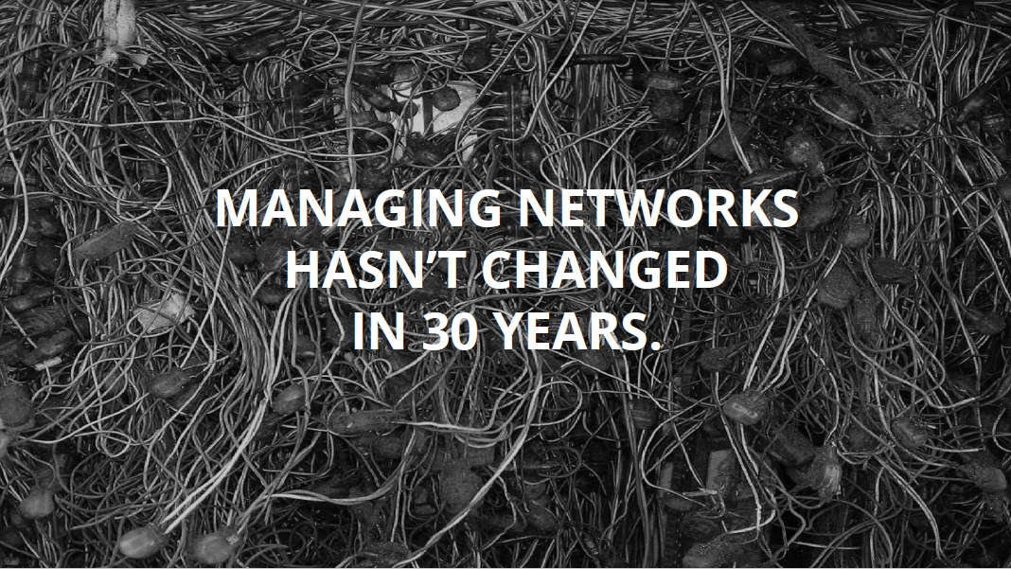

Slide 10
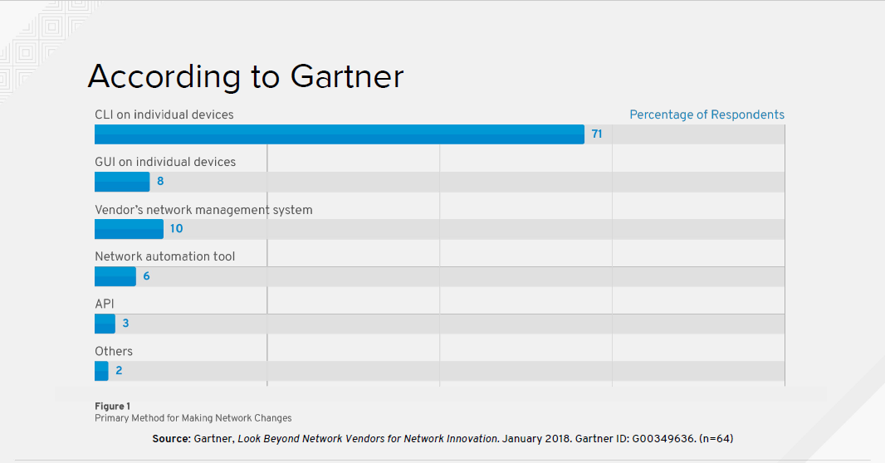
Notes:
Primary method for Making Network Changes
It’s important to note that 71% of network vendors manage their products using Command Line Interfaces

Slide 11
Automatic considerations
Compute is no longer the slowest link in the chain
Businesses demand that networks deliver at the speed of cloud
Automation of repeatable tasks
Bridge silos
Notes:
With the creation of the cloud demand has skyrocketed for faster delivery
Business’s demand that network configuration become a consistent, repeatable automatable process
To meet this need, vendors are turning to Ansible to provide automation at the Network level
In fact, many of the top network vendors are contributing back upstream into the Ansible source code tree, providing new modules that can be used to manage their products

Slide 12
Common Use Cases
Anything an operator can do manually, Ansible can automate
Backup and restore device configurations
Upgrade network device OS
Ensure Configuration Compliance
Apply patches to address CVE (Common Vulnerabilities and Exposures)
Generate dynamic documentation

Slide 13
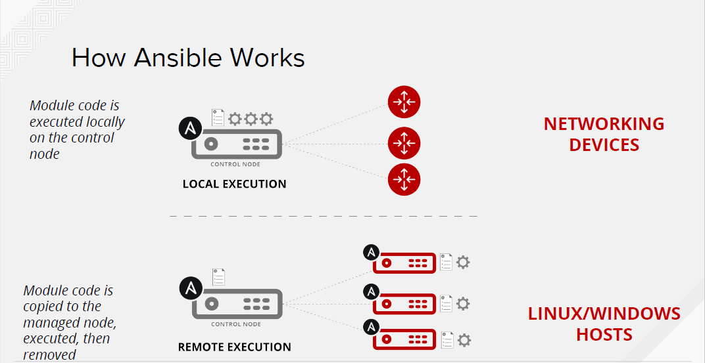

Slide 14
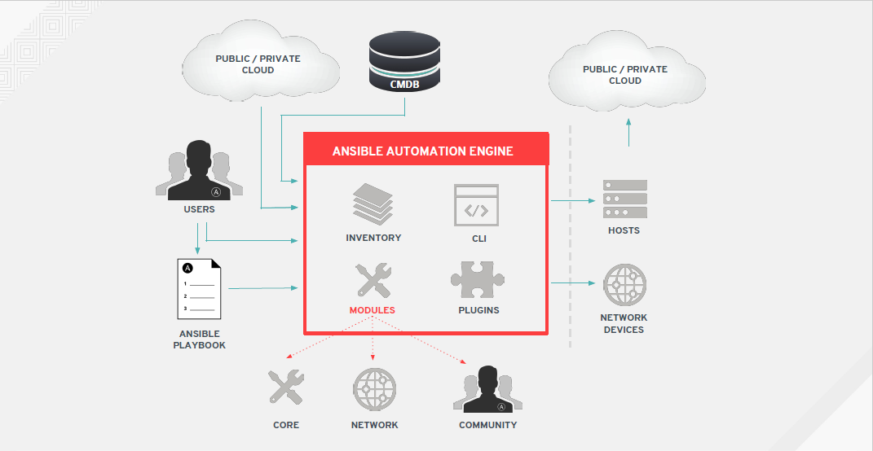

Slide 15
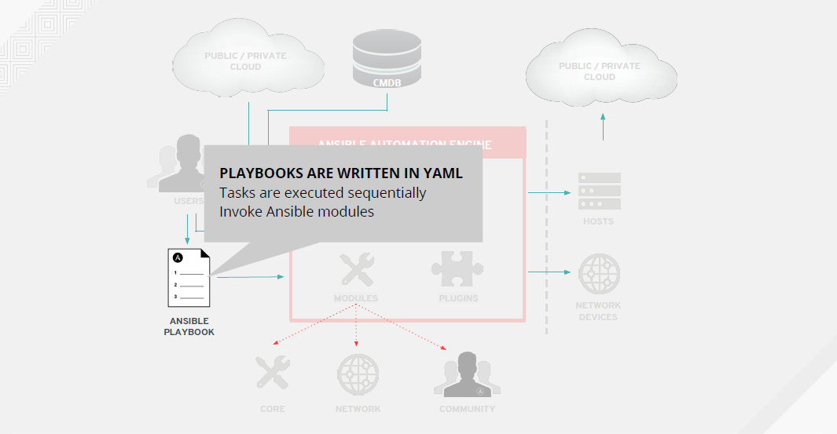

Slide 16
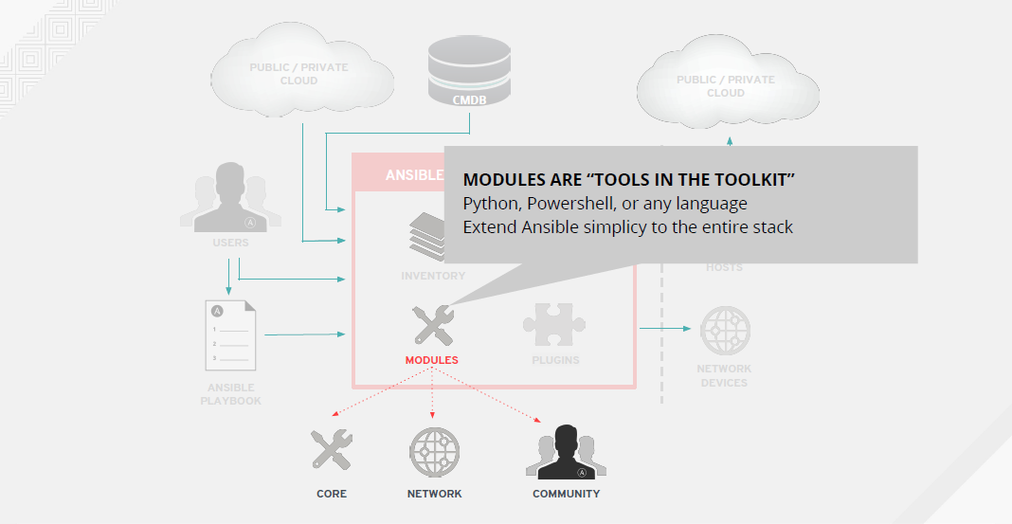

Slide 17
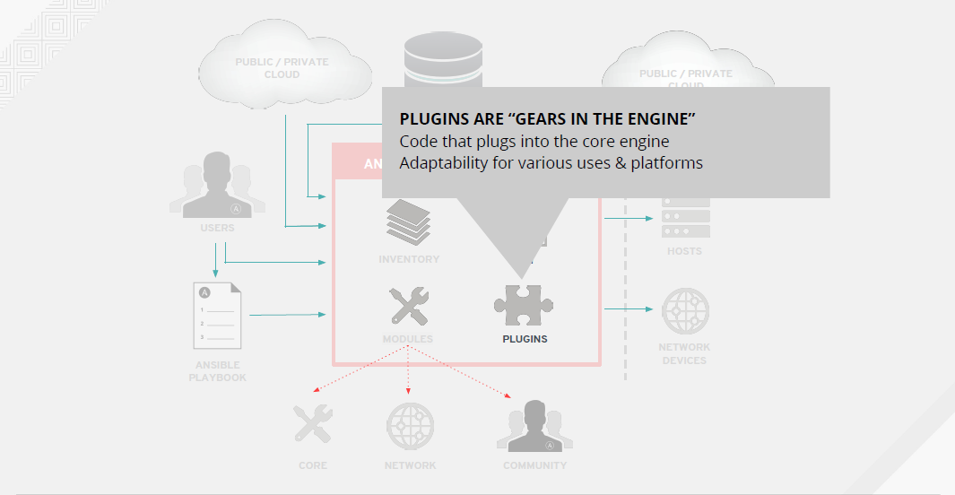

Slide 18
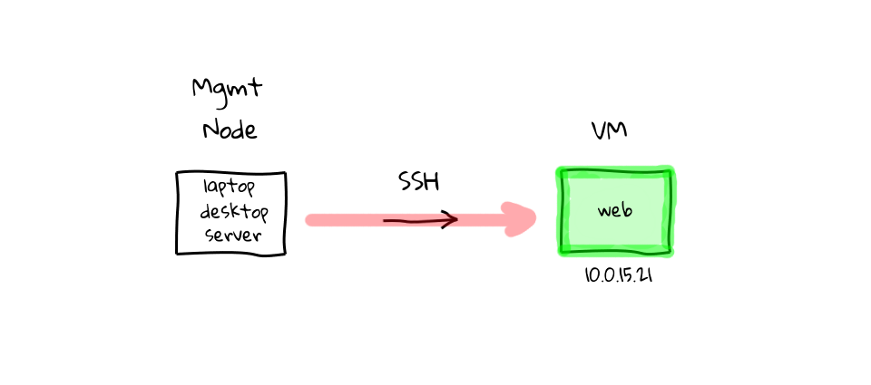
How ANSIBLE Works – Simplicity – Command Line
$ ansible all -m ping

Slide 19
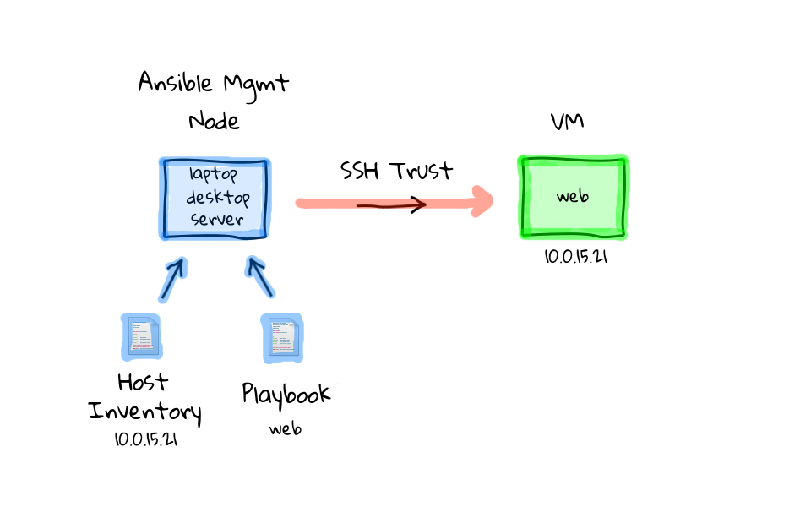
How ANSIBLE Works – Simplicity - playbook
$ ansible-playbook simple_playbook.yml

Slide 20
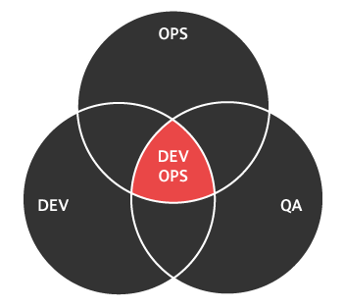
How ANSIBLE Works – Inventory file example
[web] r2d2.example.com c3po.example.com
[dbservers] mysql.example.com postgre.example.com

Slide 21

How ANSIBLE Works – Playbook
---
- name: install and start apache
hosts: web
vars:
http_port: 80
max_clients: 200
remote_user: root
tasks:
- name: install httpd
yum: pkg=httpd state=latest
- name: write the apache config file
template: src=/srv/httpd.j2 dest=/etc/httpd.conf
- name: start httpd
service: name=httpd state=running

Slide 22
How ANSIBLE Works – Playbook
---
- name: install and start apache
hosts: web
vars:
http_port: 80
max_clients: 200
remote_user: root
tasks:
- name: install httpd
yum: pkg=httpd state=latest
- name: write the apache config file
template: src=/srv/httpd.j2 dest=/etc/httpd.conf
- name: start httpd
service: name=httpd state=running

Slide 23
How ANSIBLE Works – Playbook
---
- name: install and start apache
hosts: web
vars:
http_port: 80
max_clients: 200
remote_user: root
tasks:
- name: install httpd
yum: pkg=httpd state=latest
- name: write the apache config file
template: src=/srv/httpd.j2 dest=/etc/httpd.conf
- name: start httpd
service: name=httpd state=running

Slide 24
How ANSIBLE Works – Playbook
---
- name: install and start apache
hosts: web
vars:
http_port: 80
max_clients: 200
remote_user: root
tasks:
- name: install httpd
yum: pkg=httpd state=latest
- name: write the apache config file
template: src=/srv/httpd.j2 dest=/etc/httpd.conf
- name: start httpd
service: name=httpd state=running

Slide 25
How ANSIBLE Works – Playbook
---
- name: install and start apache
hosts: web
vars:
http_port: 80
max_clients: 200
remote_user: root
tasks:
- name: install httpd
yum: pkg=httpd state=latest
- name: write the apache config file
template: src=/srv/httpd.j2 dest=/etc/httpd.conf
- name: start httpd
service: name=httpd state=running

Slide 26
How ANSIBLE Works – Playbook
---
- name: install and start apache
hosts: web
vars:
http_port: 80
max_clients: 200
remote_user: root
tasks:
- name: install httpd
yum: pkg=httpd state=latest
- name: write the apache config file
template: src=/srv/httpd.j2 dest=/etc/httpd.conf
- name: start httpd
service: name=httpd state=running

Slide 27
How ANSIBLE Works – Playbook
---
- name: install and start apache
hosts: web
vars:
http_port: 80
max_clients: 200
remote_user: root
tasks:
- name: install httpd
yum: pkg=httpd state=latest
- name: write the apache config file
template: src=/srv/httpd.j2 dest=/etc/httpd.conf
- name: start httpd
service: name=httpd state=running

Slide 28
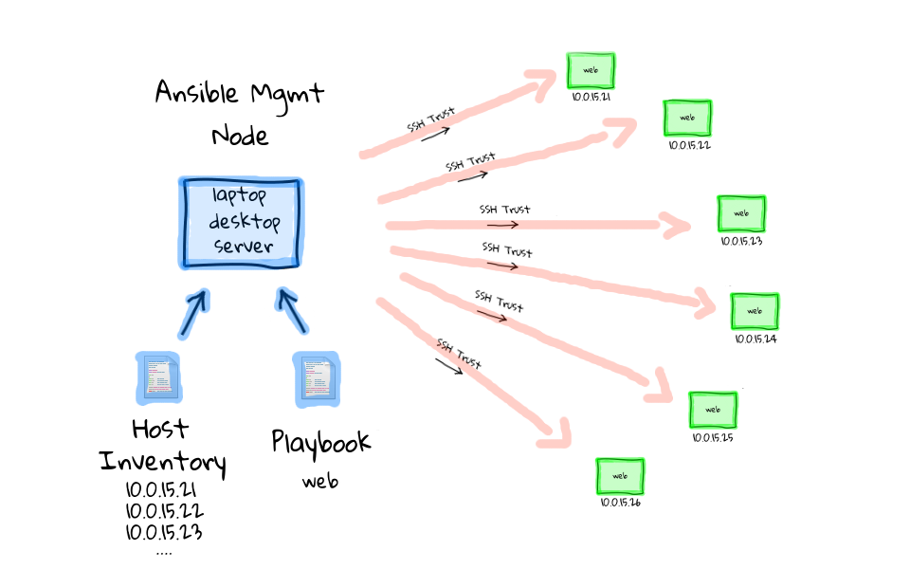
How ANSIBLE Works – at scale
$ ansible-playbook simple_playbook.yml

Slide 29
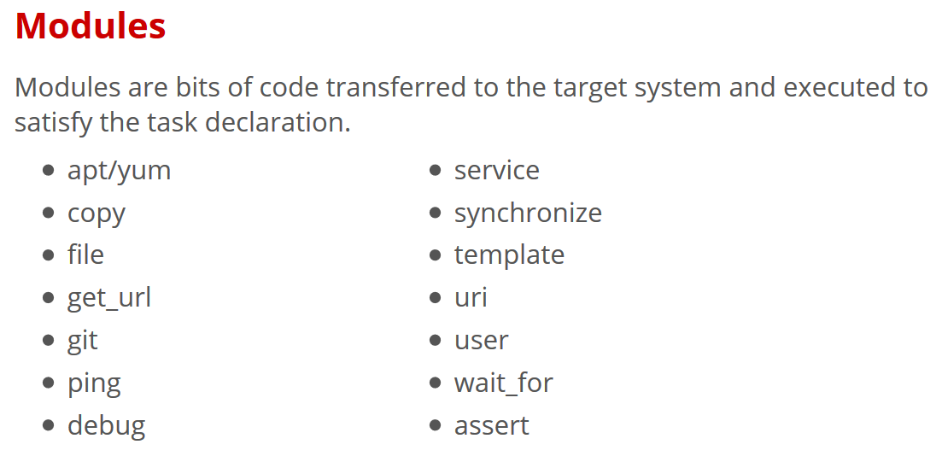
$ ansible all -m ping

Slide 30
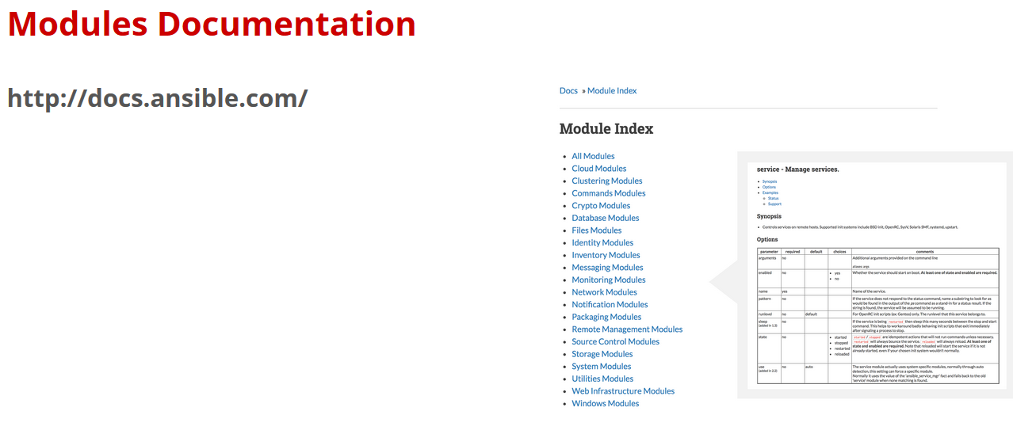

Slide 31
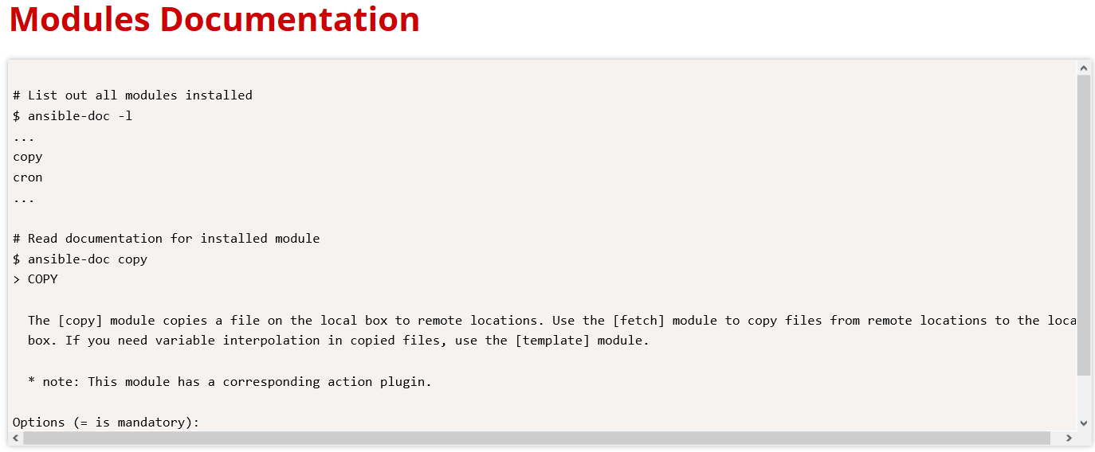

Slide 32
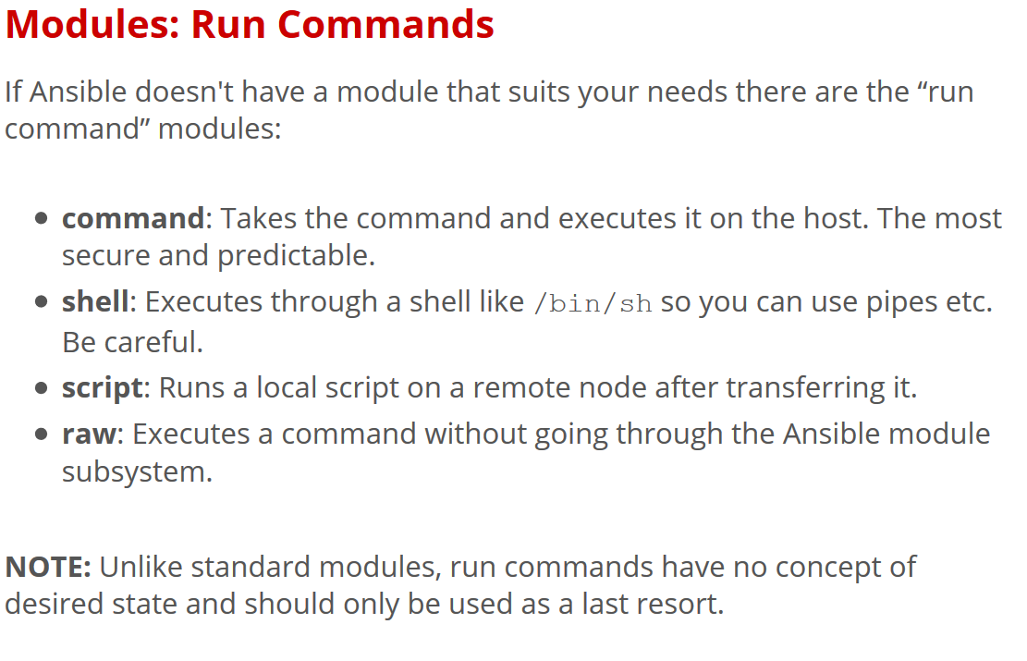

Slide 33
AD-Hoc Commands
# Check all my inventory hosts are ready to be managed
$ ansible all –m ping
# Collect and Display discovered facts for localhost
$ ansible localhost –m setup
# run the uptime command on all hosts in the WEB group
$ ansible web –m command –a “uptime”

Slide 34
Sidebar: Discovered Facts
Facts are bits of information derived from examining a host system, these are stored as variables for later use in the play.
$ ansible localhost –m setup
localhost | success >> {
“ansible_facts”: {
“ansible_default_ipv4”: {
“address”: “192.168.1.27”,
“alias”: “wlan0”,
“gateway: “192.168.1.1”,
“interface: “wlan0”,
“macaddress”: “c4:85:08:3b:a9:16”,
.
.

Slide 35
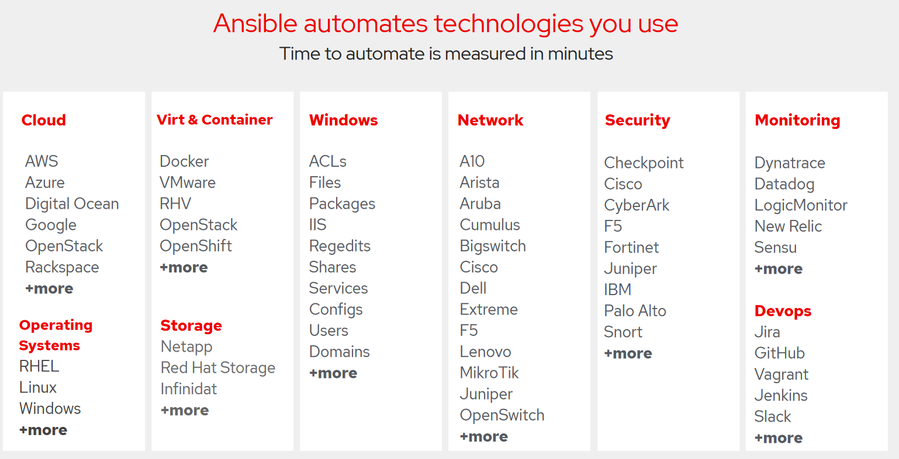

Slide 36
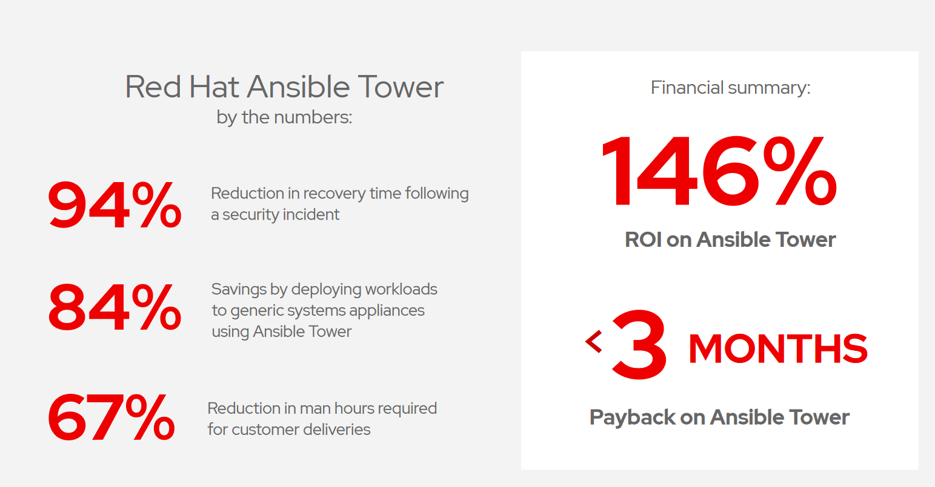
SOURCE: "The Total Economic Impact™ Of Red Hat Ansible Tower, a June 2018
commissioned study conducted by Forrester Consulting
on behalf of Red Hat."redhat.com/en/engage/total-economic-impact-ansible-tower-20180710

Slide 37
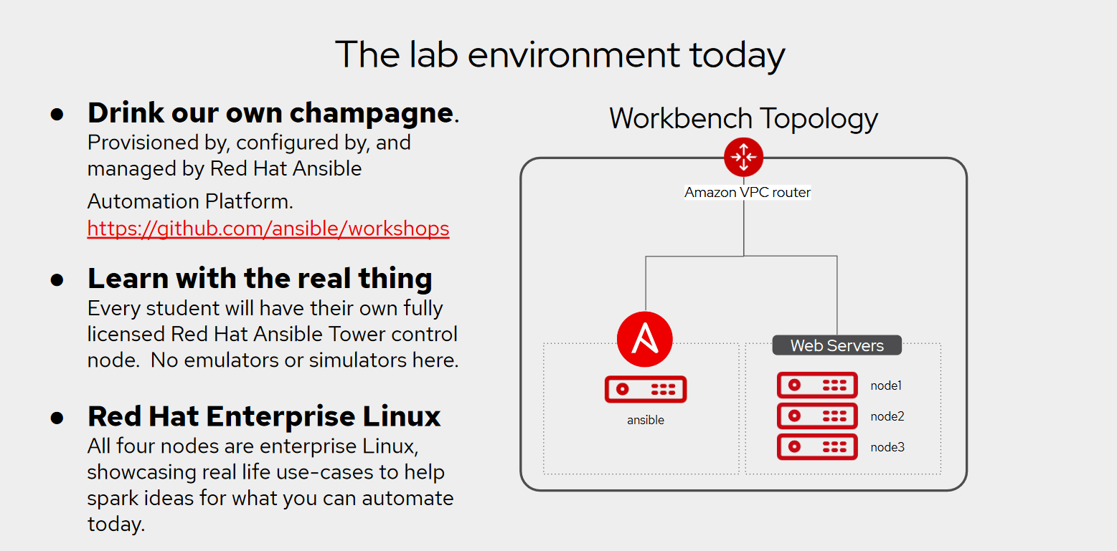

Slide 38
Lab Location
http://3dc6.rhdemo.io/

Slide 39
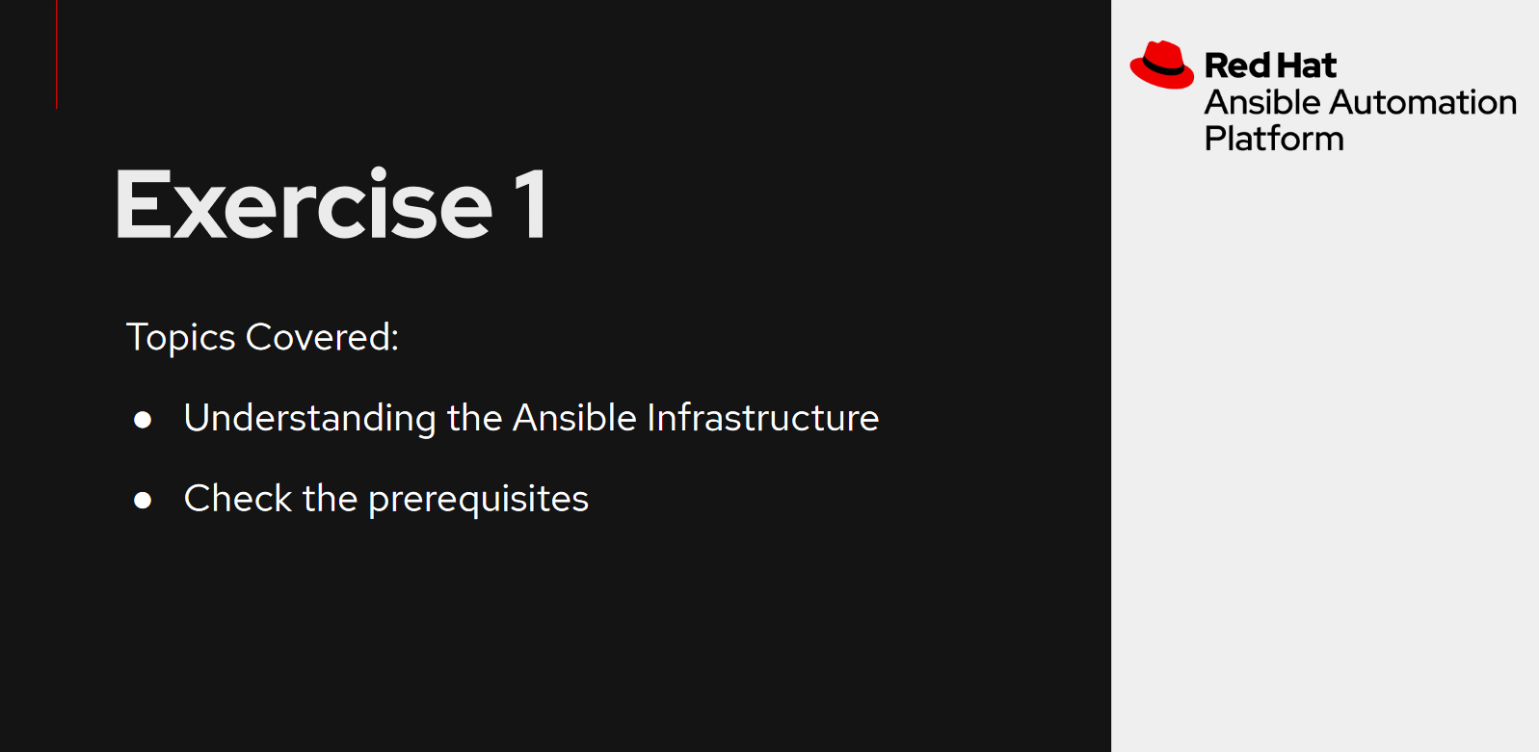

Slide 40
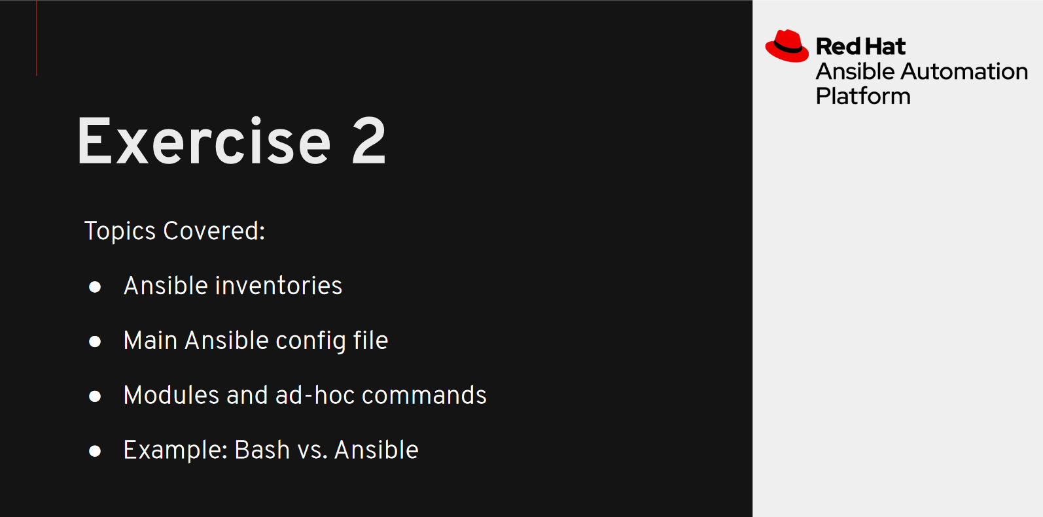

Slide 41
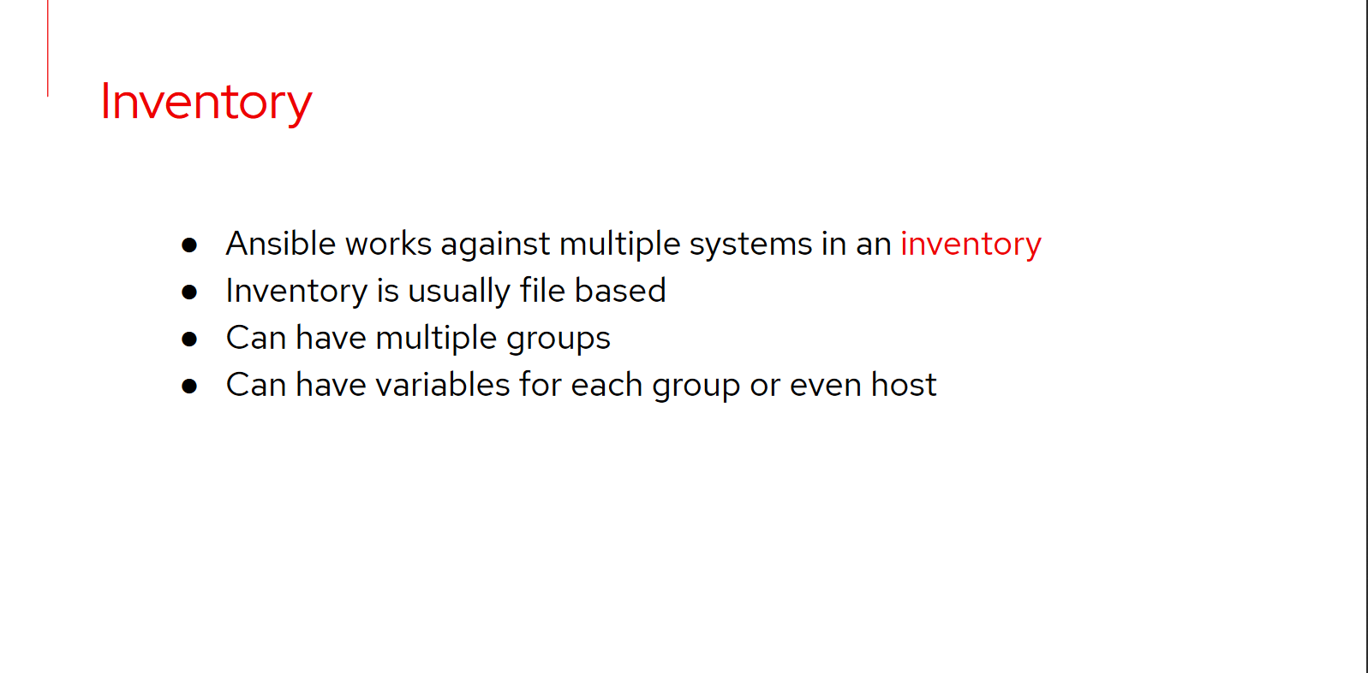

Slide 42
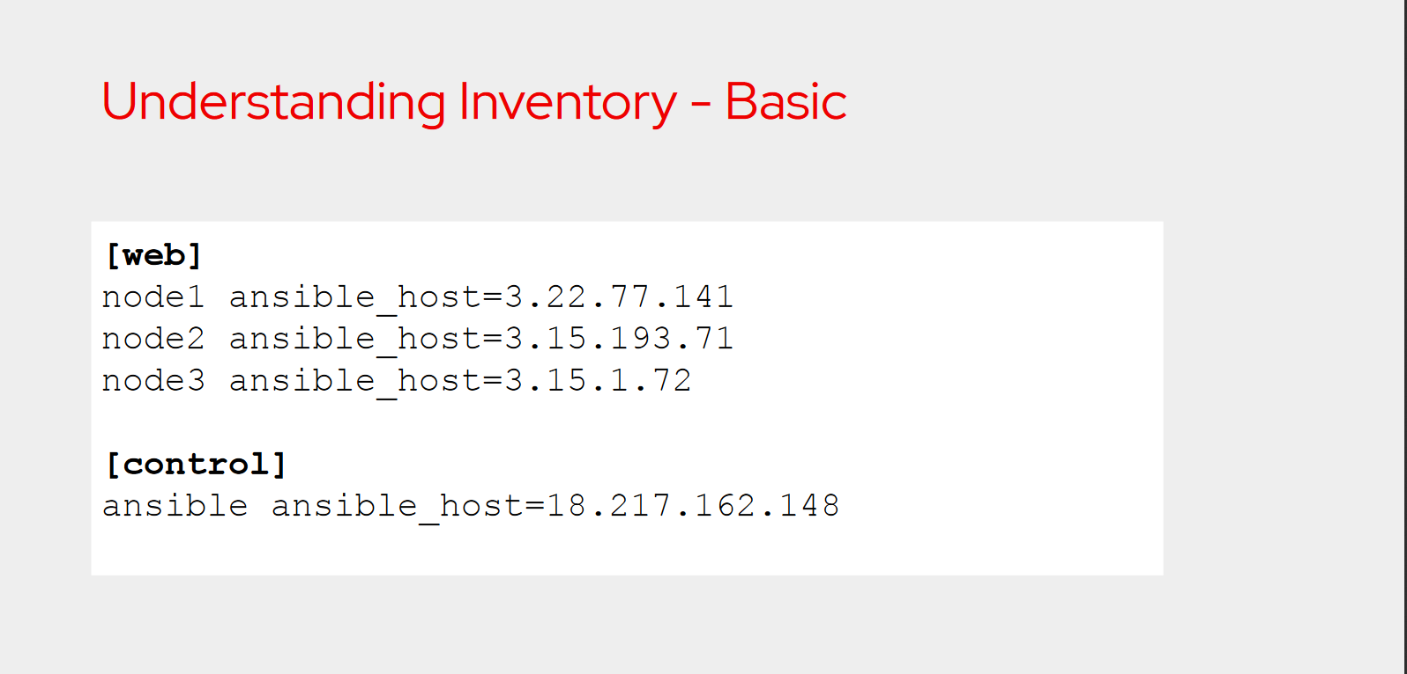

Slide 43
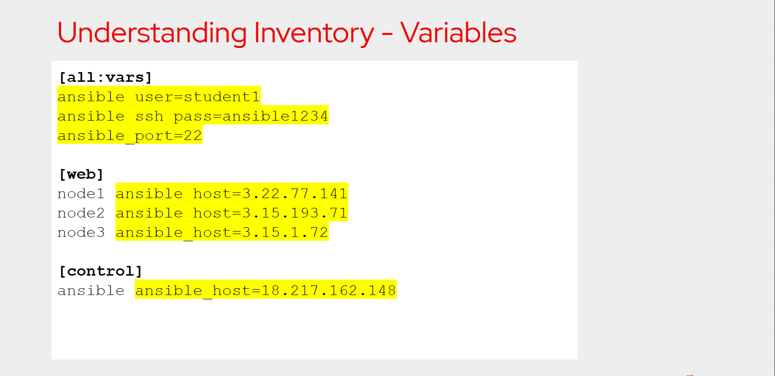

Slide 44
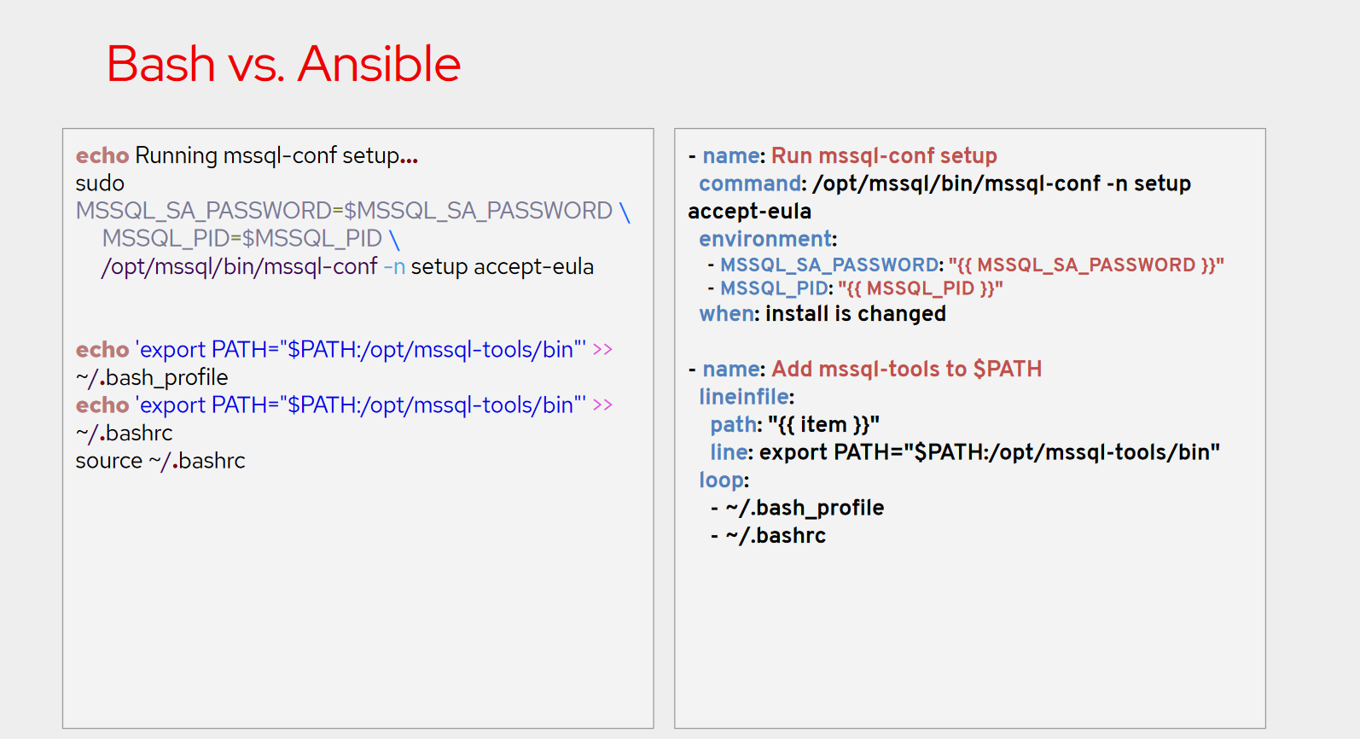

Slide 45
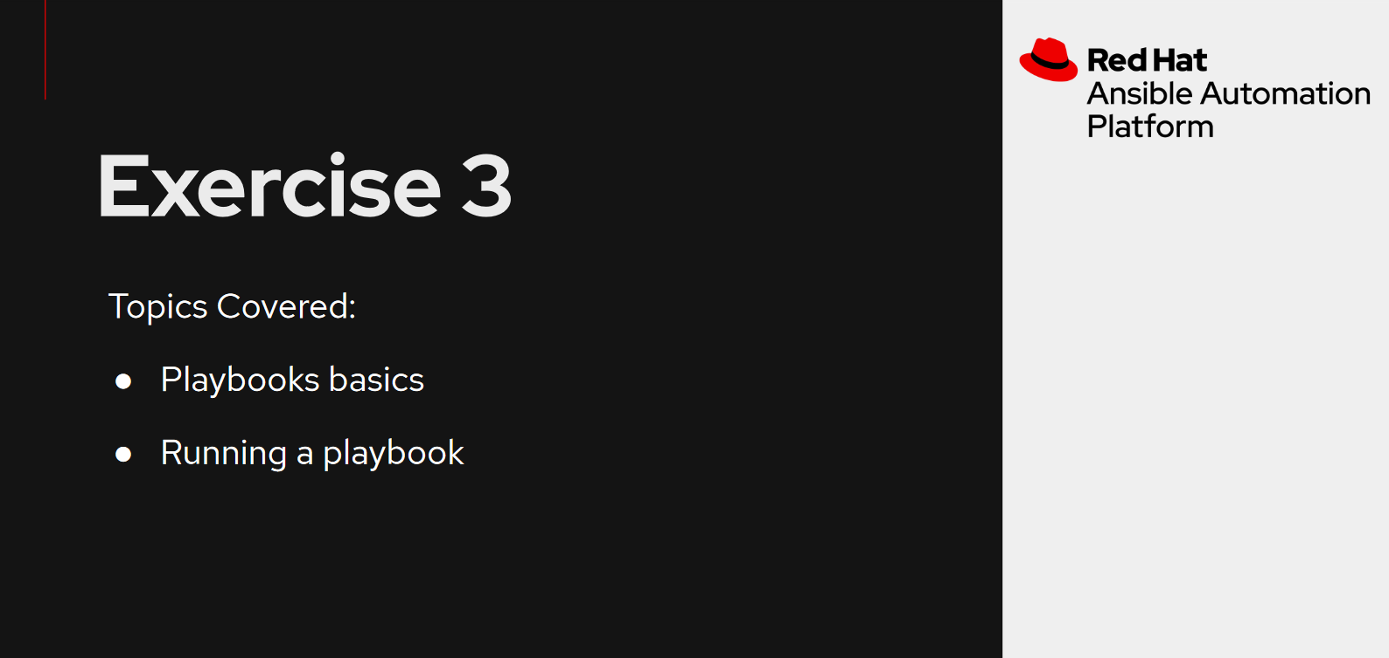

Slide 46
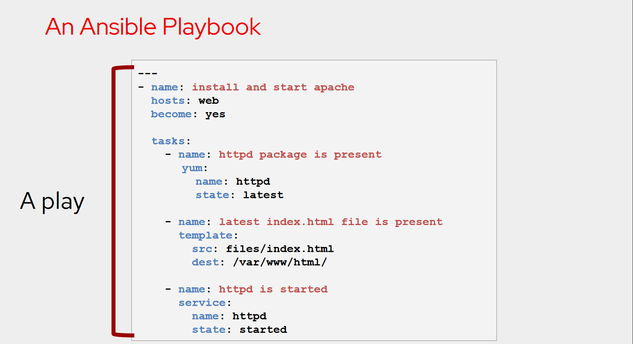

Slide 47
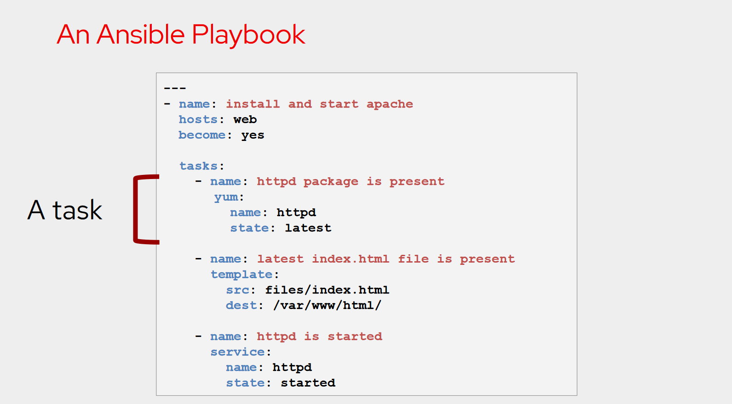

Slide 48
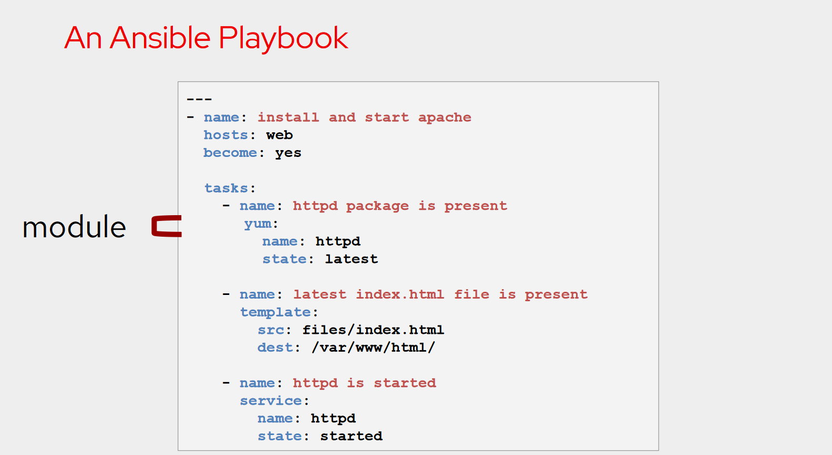

Slide 49
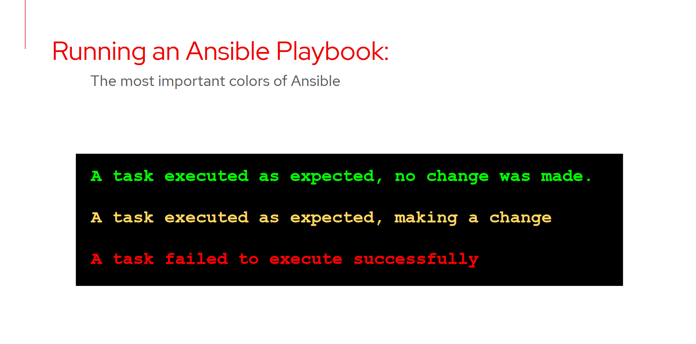

Slide 50
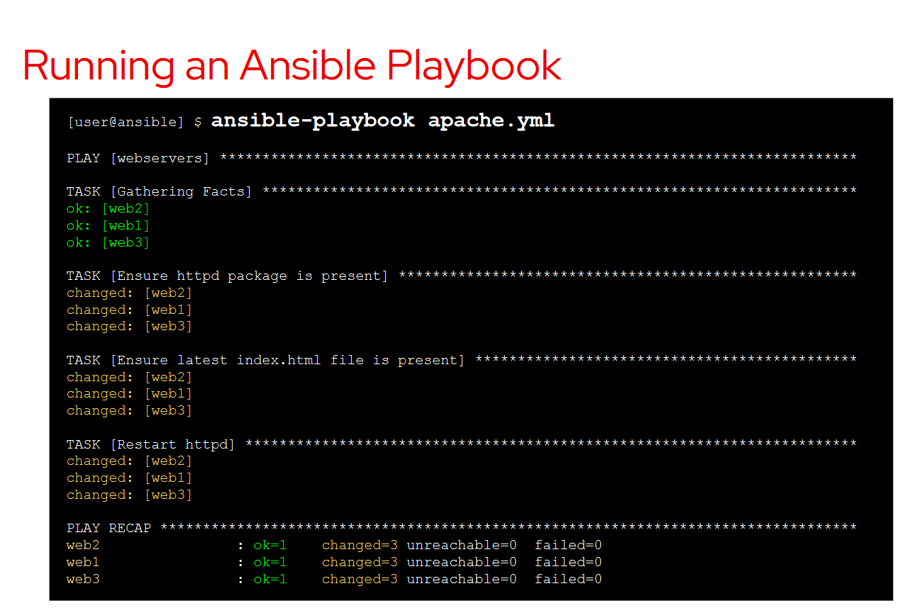

Slide 51
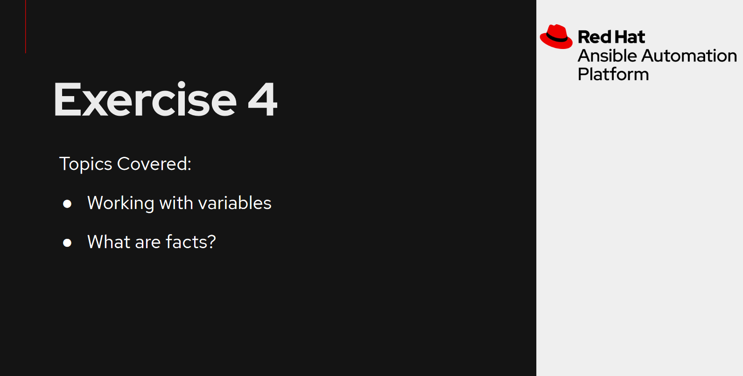

Slide 52
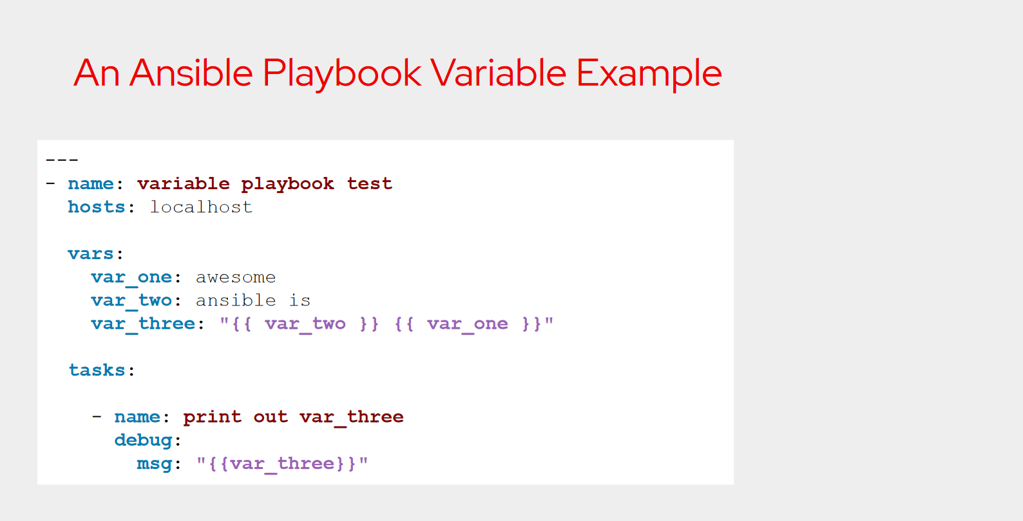

Slide 53
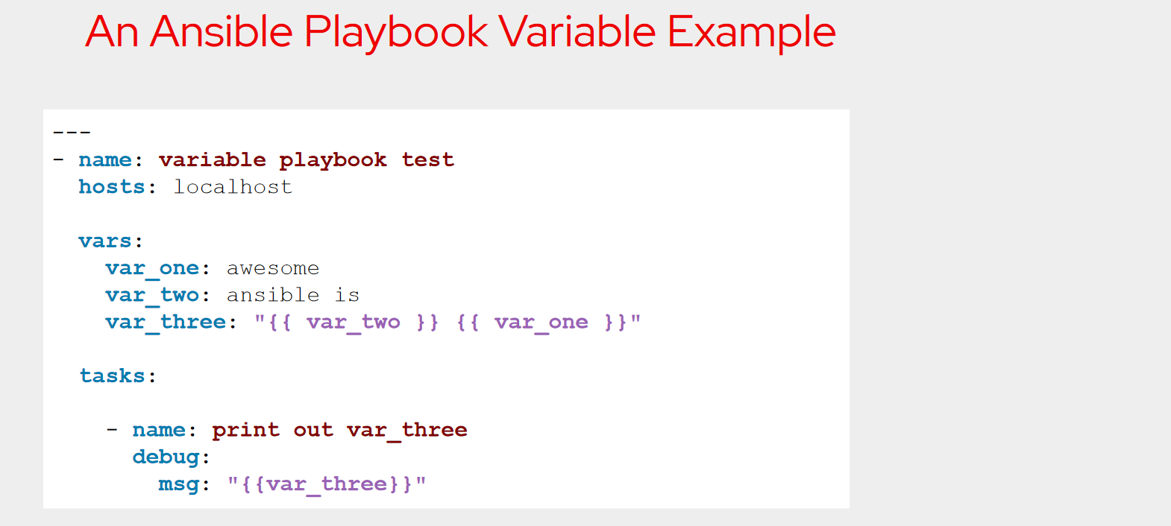

Slide 54
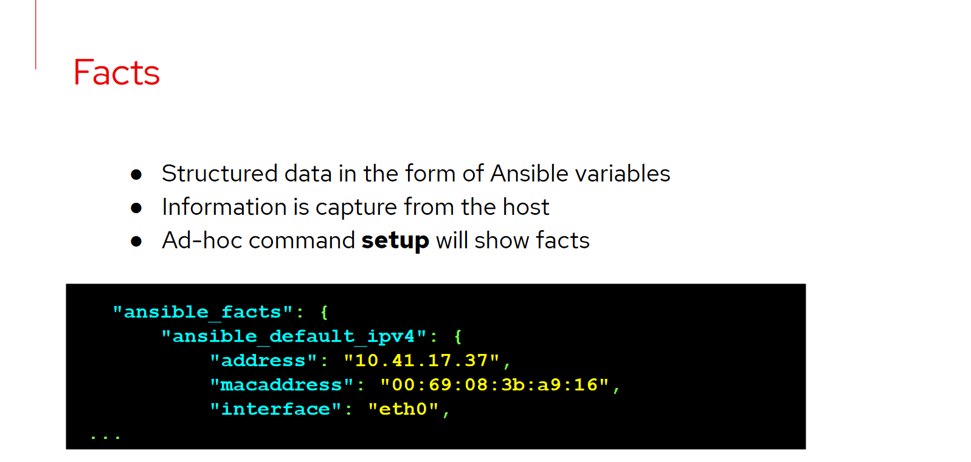

Slide 55
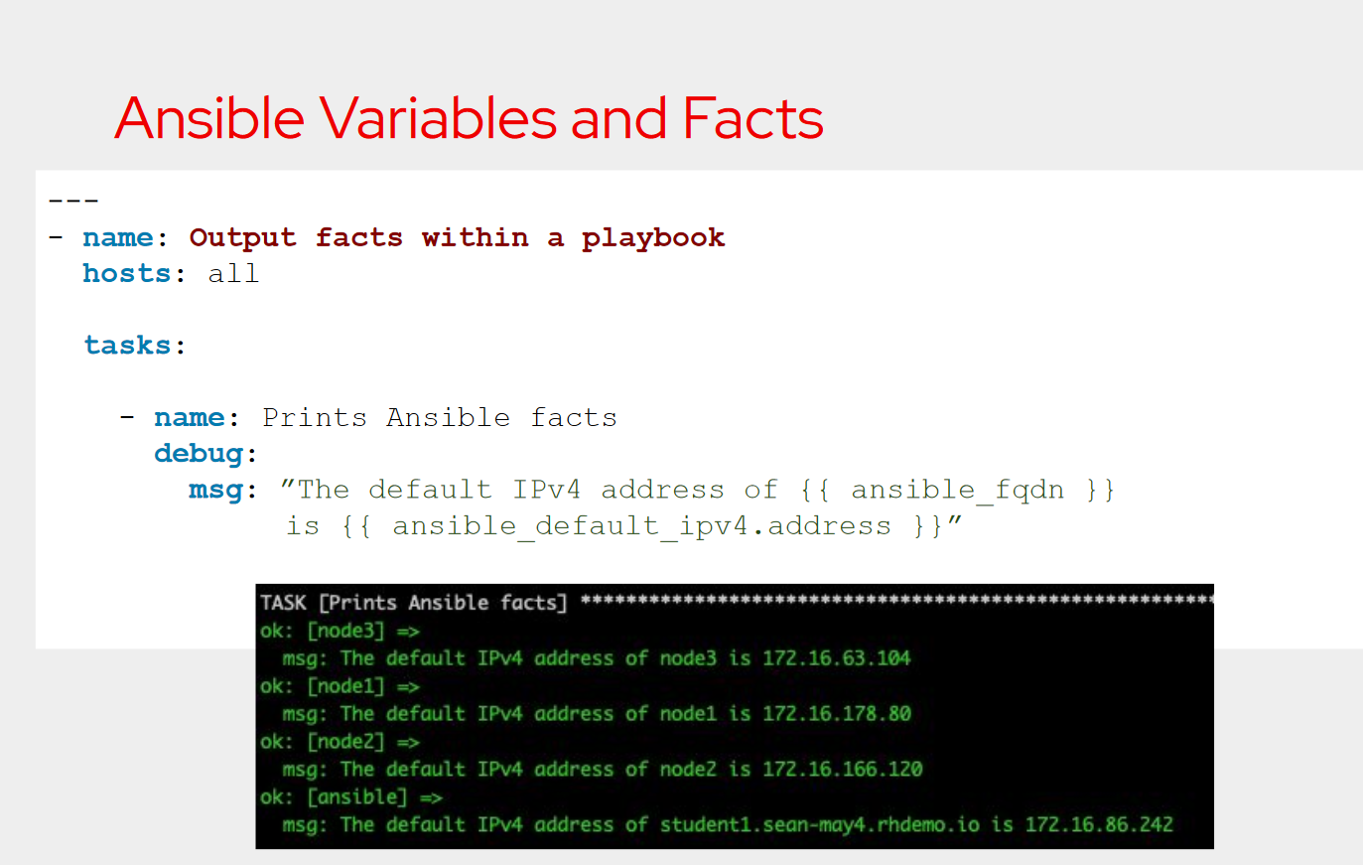

Slide 56
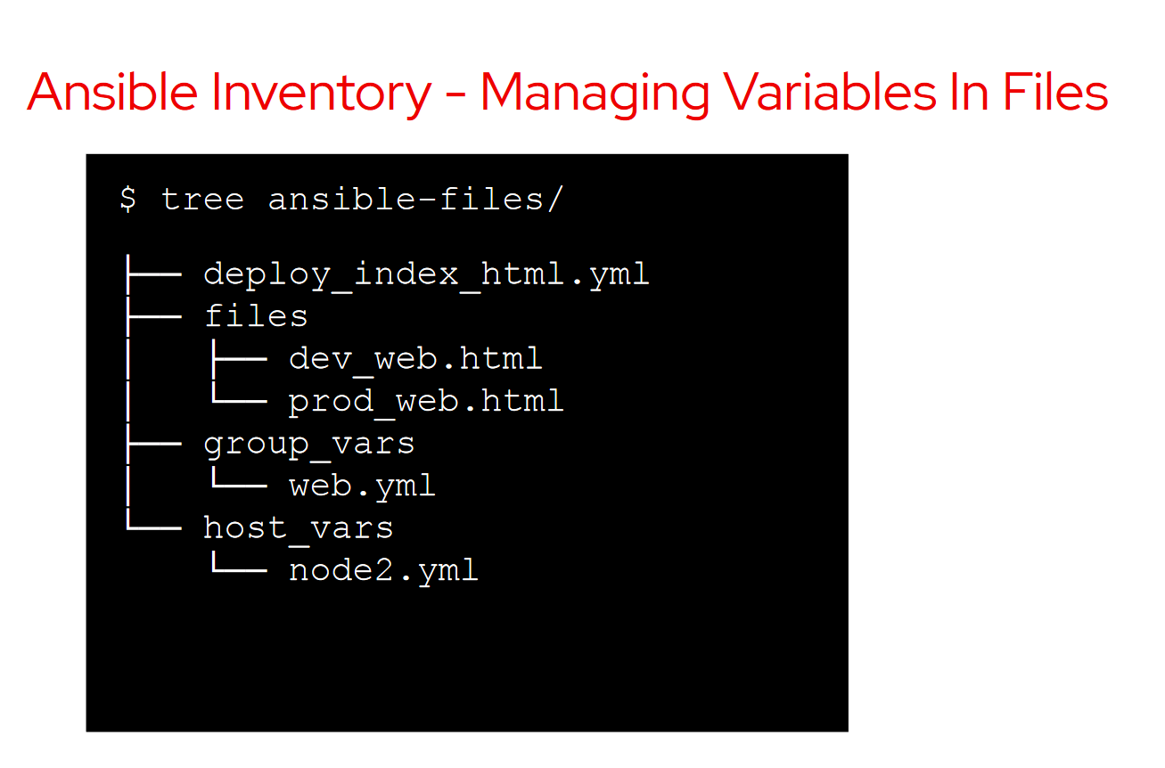

Slide 57
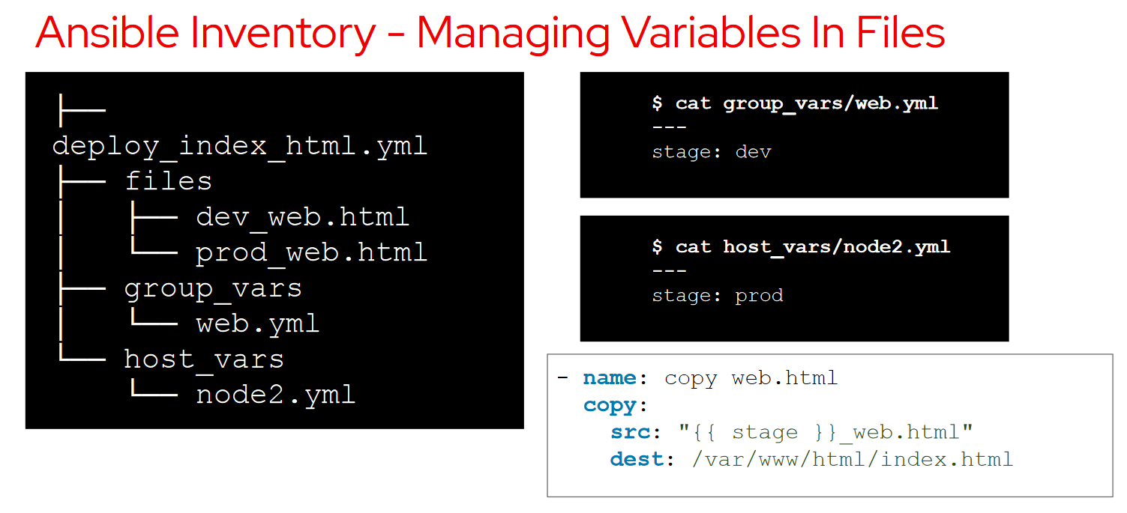

Slide 58
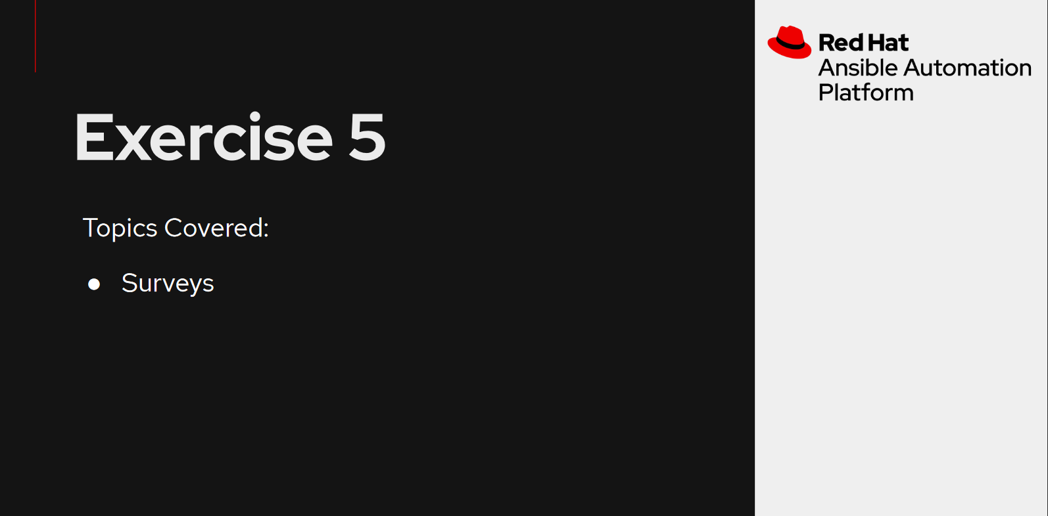

Slide 59
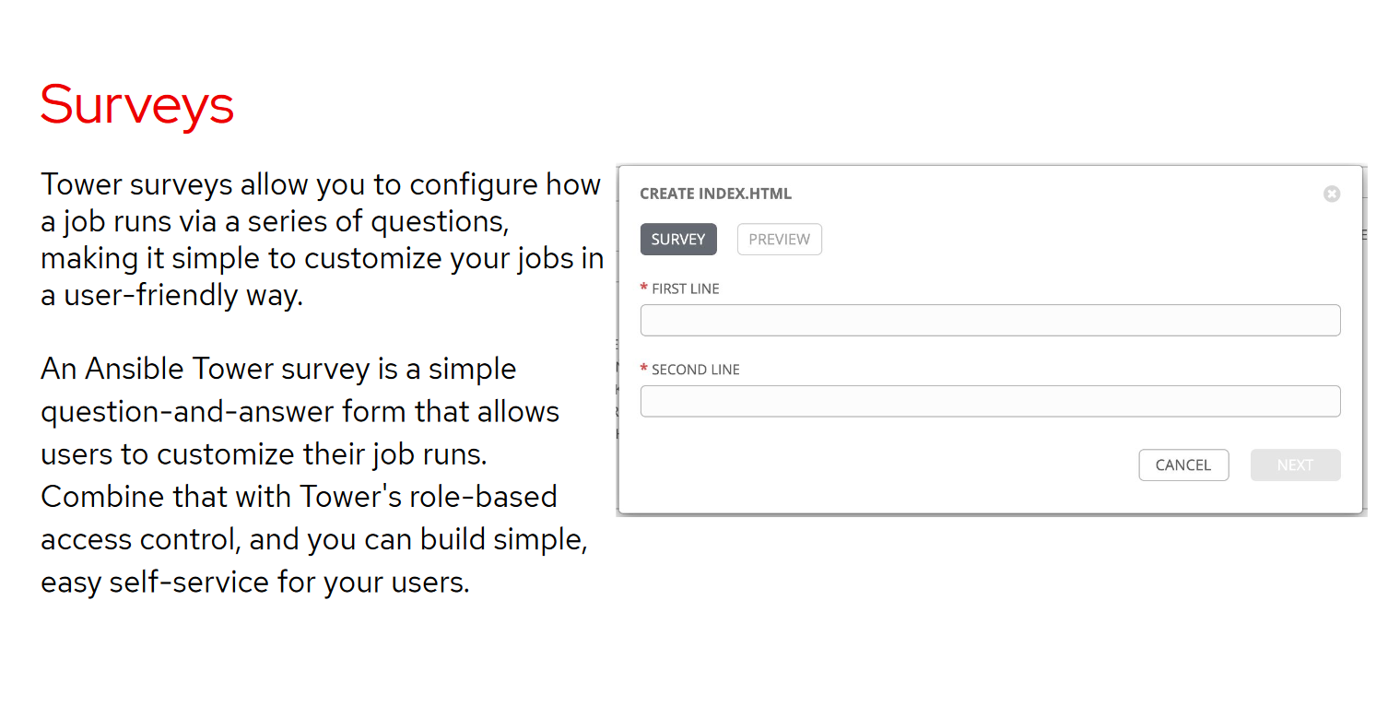

Slide 60
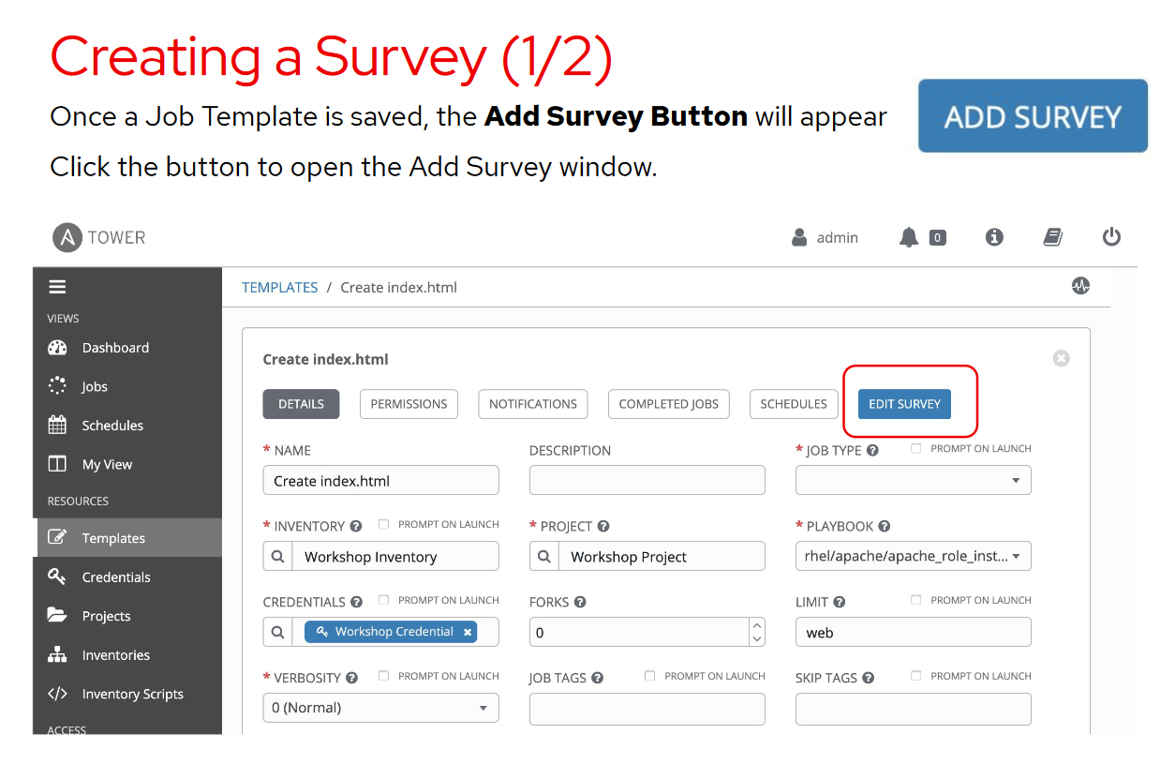

Slide 61
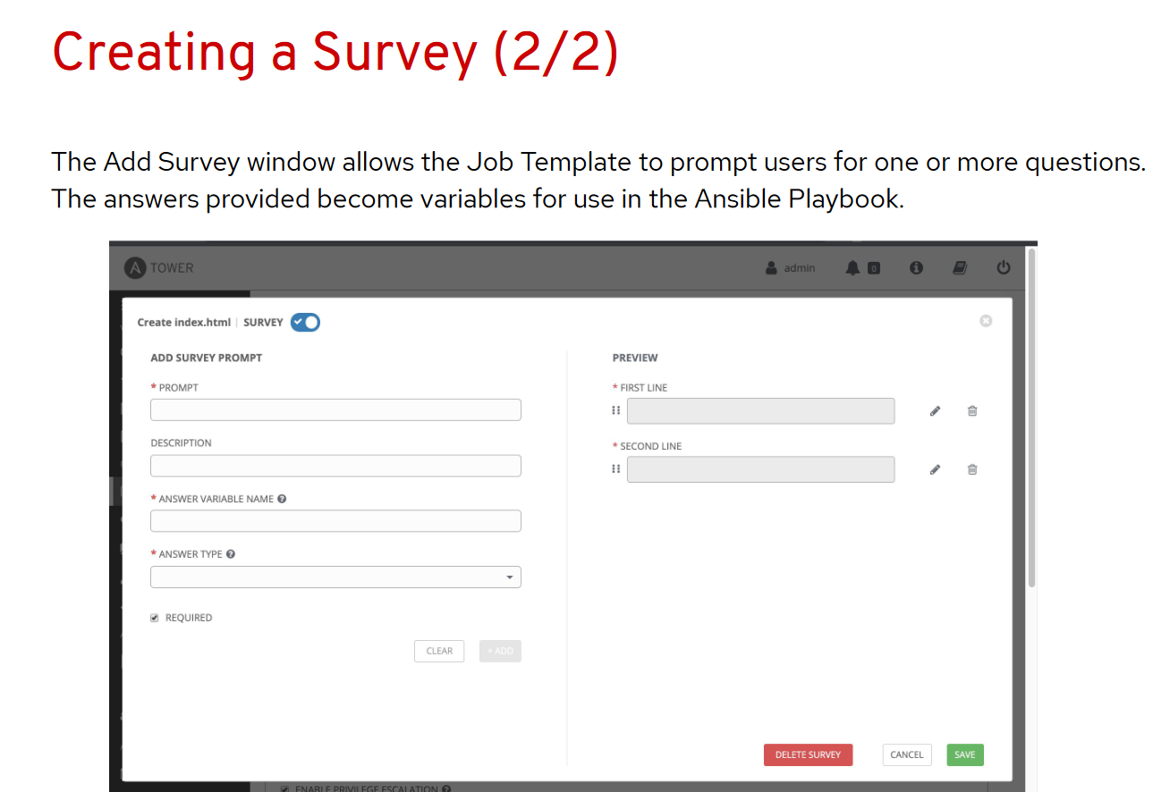

Slide 62
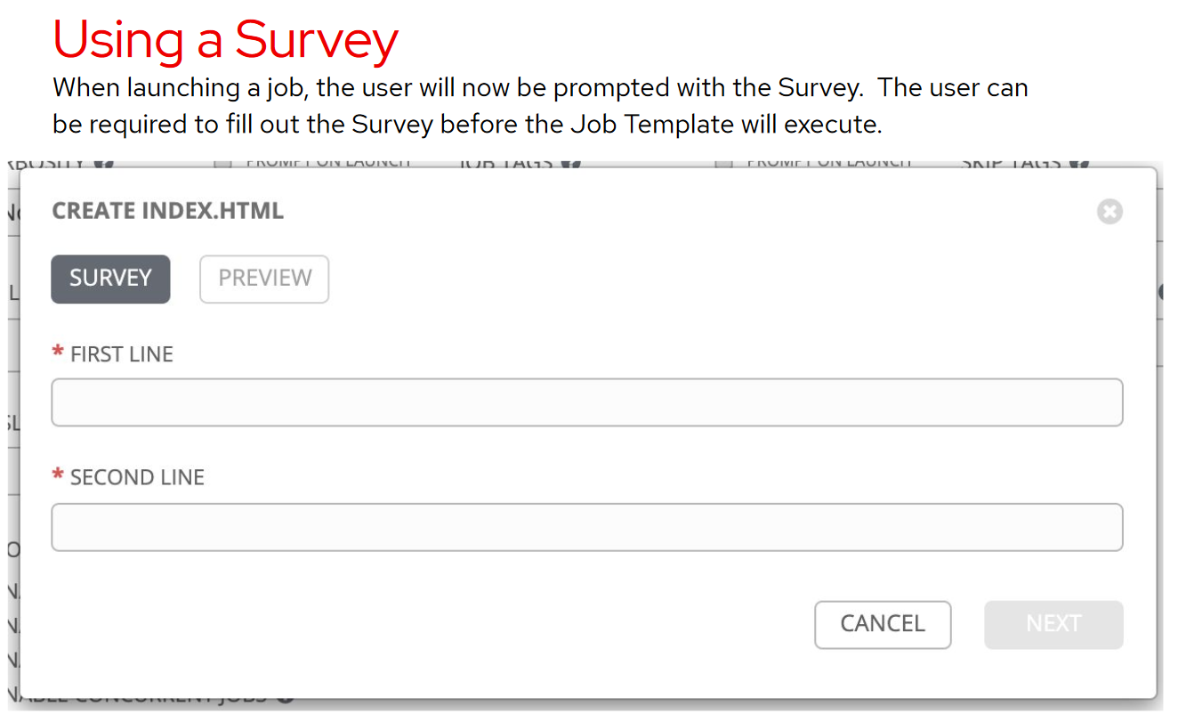

Slide 63
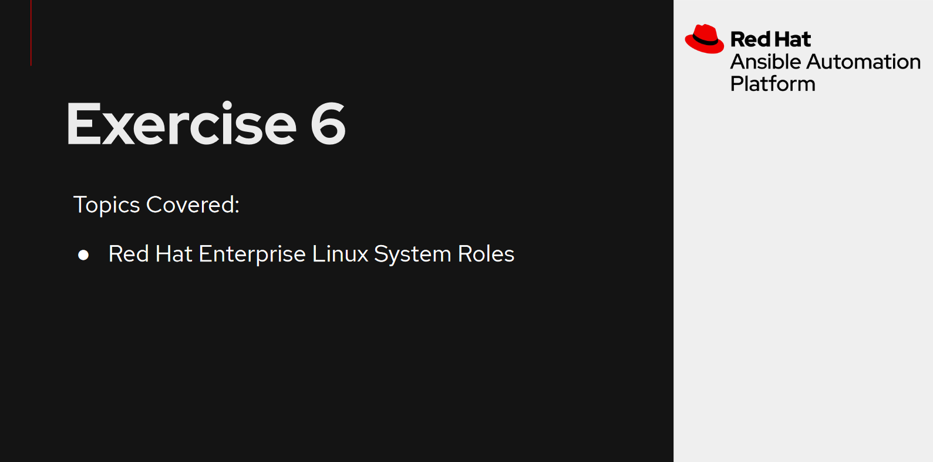

Slide 64
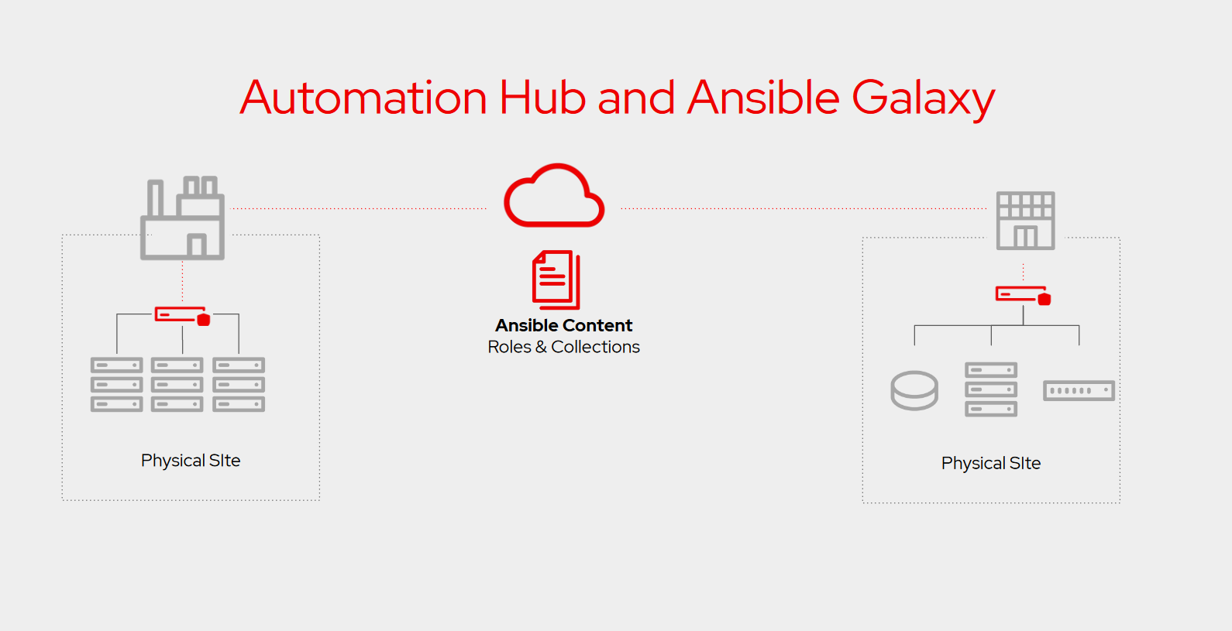

Slide 65
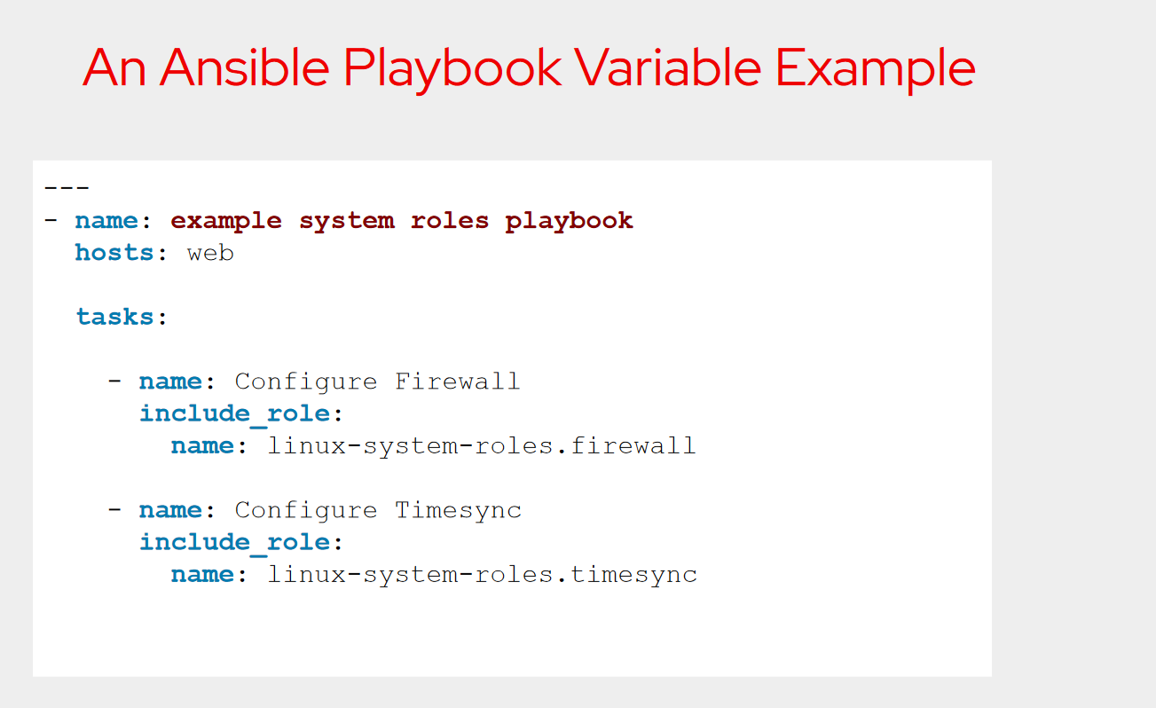

Slide 66
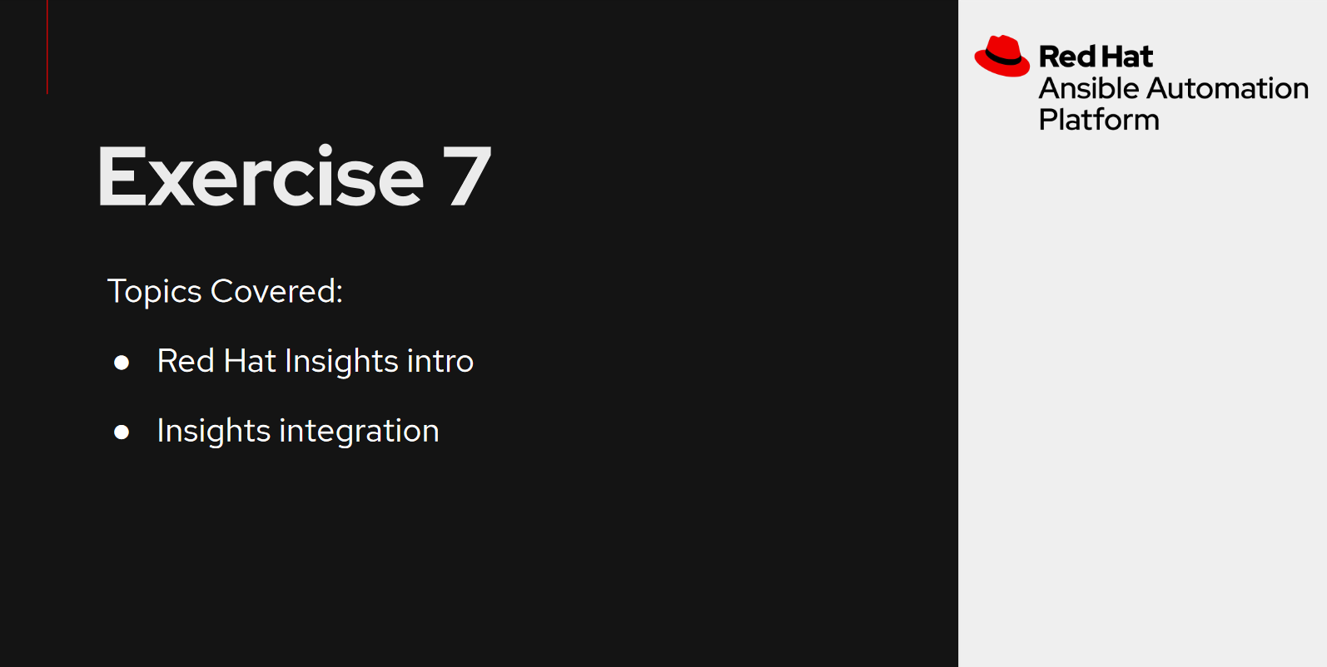

Slide 67
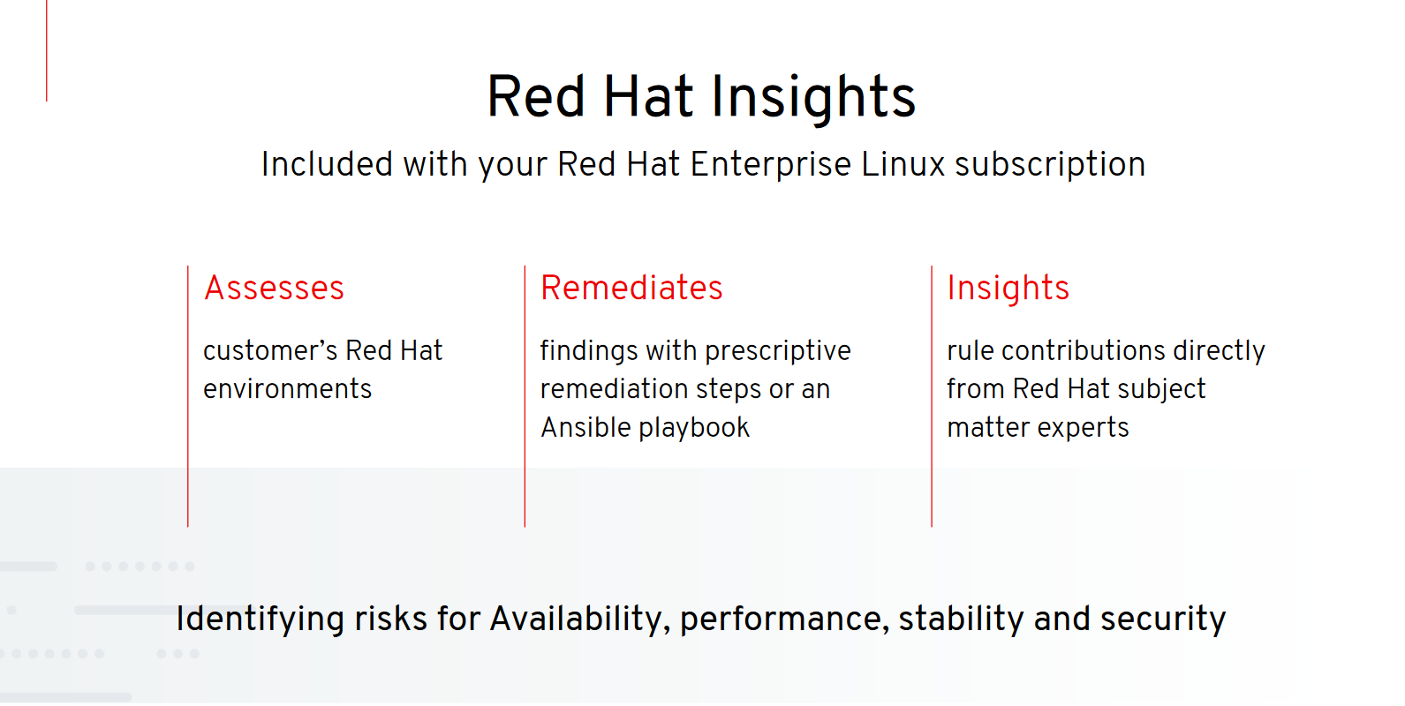

Slide 68


Slide 69


Slide 70
Next Steps
Get Started
ansible.com/get-started
ansible.com/tower-trial
Workshops and Training
ansible.com/workshops
Red Hat Training
Join the Community
ansible.com/community
Share Your Story
Follow Us@Ansible
Friend Us On Facebook

Slide 71
THANK YOU
plus.google.com/+RedHat
facebook.com/redhatinc
linkedin.com/company/red-hat
twitter.com/RedHatNews
youtube.com/user/RedHatVideos

